Slide 1
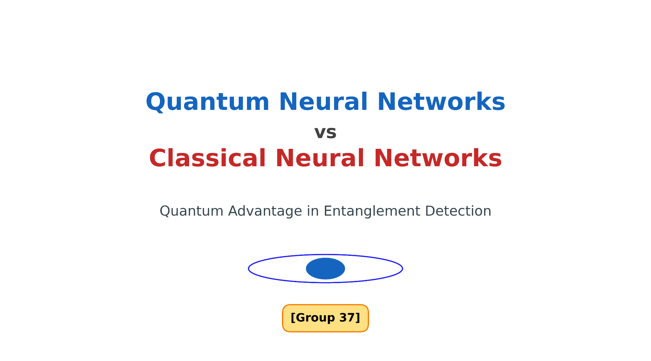
By: Rhik Mazumder, Aryan Jain

Slide 2
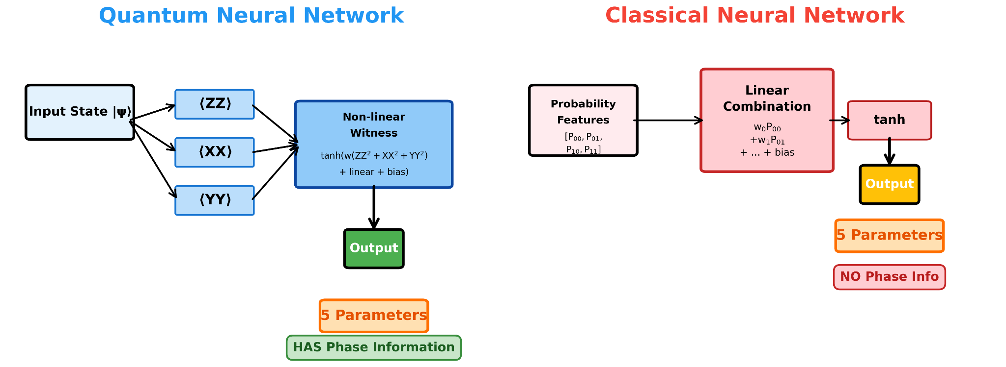
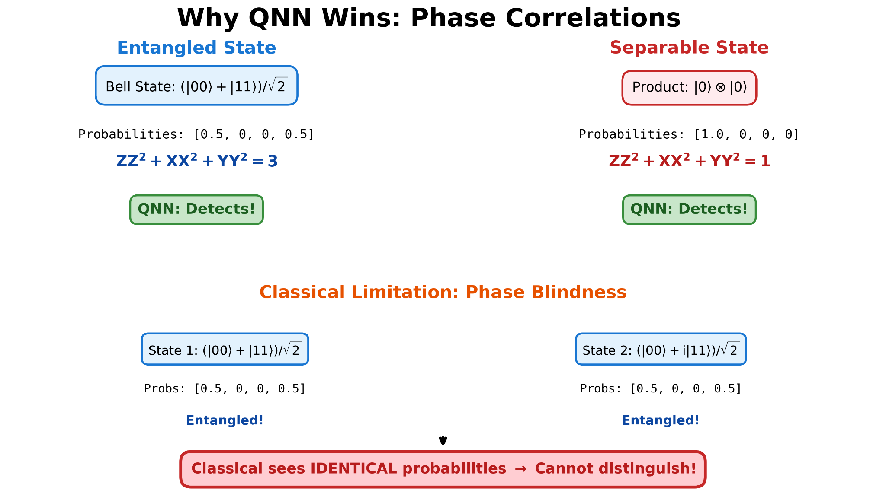
Project Overview
Goal: Extend Needle to support Quantum Neural Networks (QNNs)
We add a quantum operations layer and QNN module that wraps these operations with learnable parameters, integrating with autograd
QNNs measure quantum correlations that classical models can't access without phase information
Notes:
Our goal was to extend Needle to support Quantum Neural Networks. We do this by adding a quantum operations layer

Slide 3
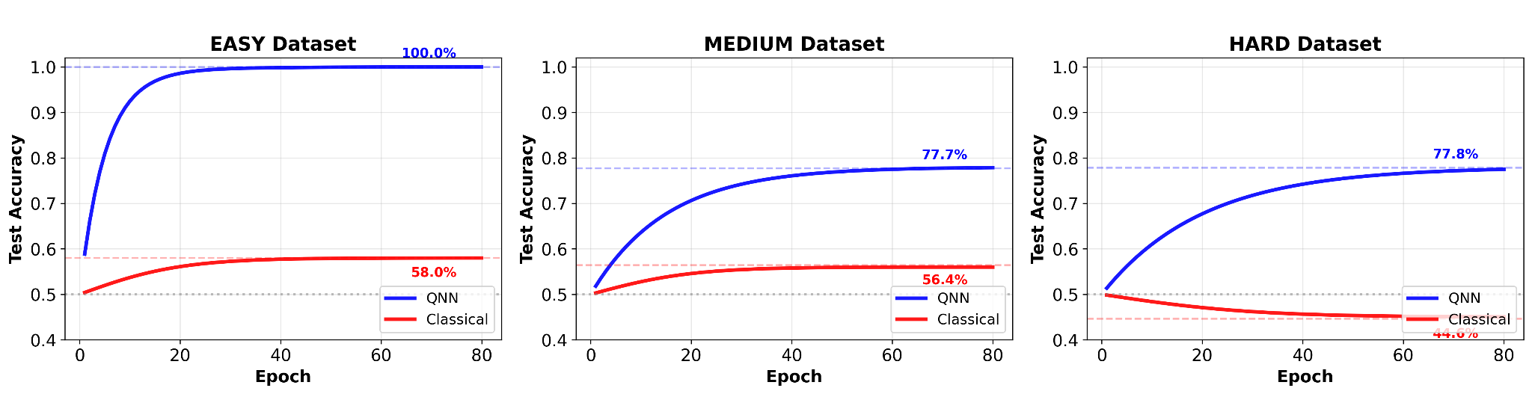
Project Results: Analyzing QNN vs classical NN performance
Created 3 different quantum entanglement datasets, with varying difficulty
We trained comparable QNNs and classical NNs and use the same optimizers, learning rates, and parameter count (5)
QNNs consistently plateau at a higher test accuracy than classical NNs:
Notes:
Bell states, bell states with rotations, partially entangled states

Slide 4
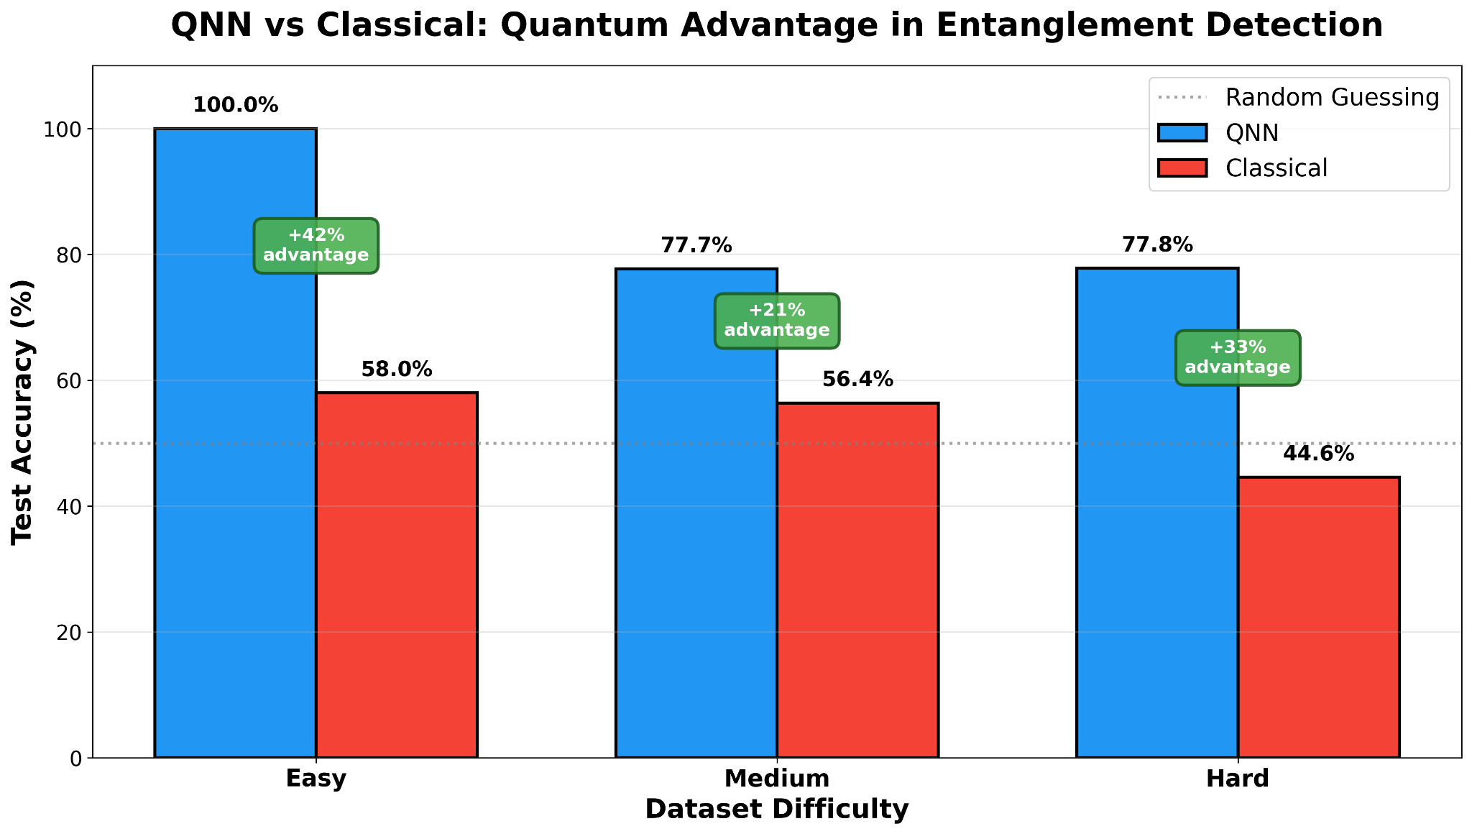
Project Results: QNNs Outperform Classical NNs in Entanglement Detection

